Slide 1
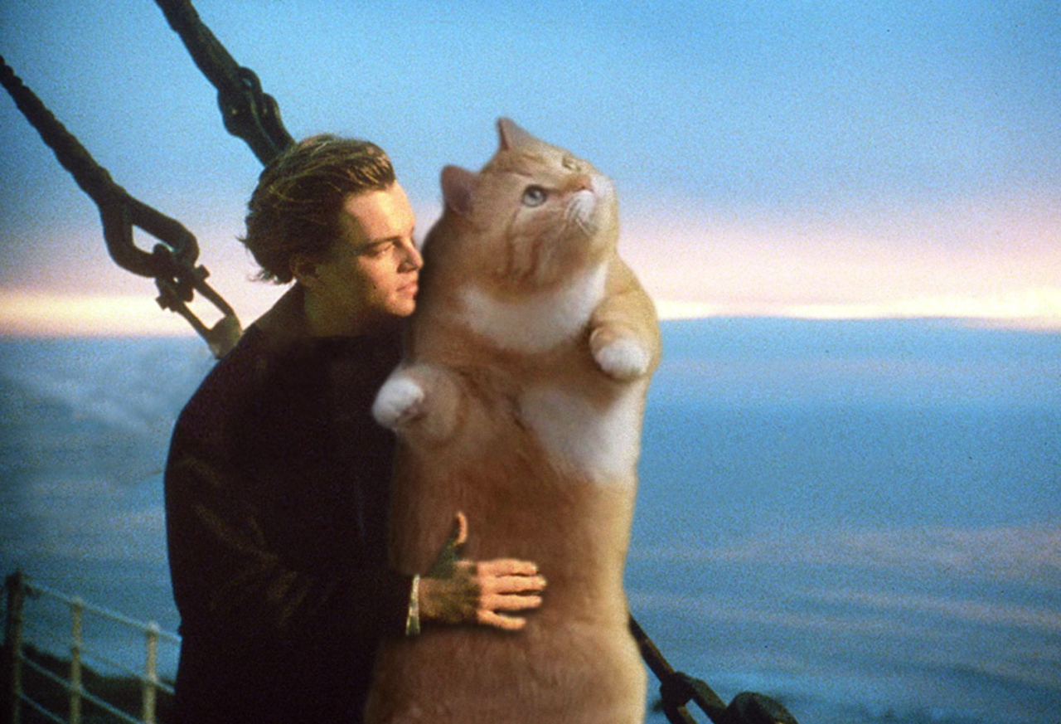
Programming Concepts II
HILT 2018

Slide 2
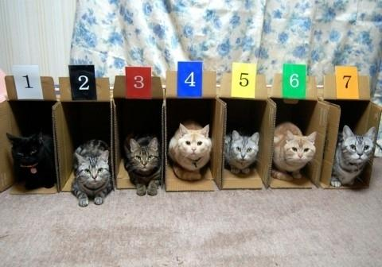
Collections

Slide 3
Collections
List:
>>> fruits = ["kiwi", "strawberry", "plum"]
>>> fruits
['kiwi', 'strawberry', 'plum']
fruits[0] = "kiwi", fruits[1] = "strawberry", etc.
Dictionary (associative array):
>>> states = {"VA": "Virginia", "MD": "Maryland"}
>>> states
{'VA': 'Virginia', 'MD': 'Maryland'}
states["VA"] = "Virginia", states["MD"] = "Maryland"

Slide 4
Loops & Iterators:
repeating yourself!
>>> fruits[0]
'kiwi'
>>> fruits[1]
'strawberry'
>>> fruits[2]
'plum'
this isn't fun or efficient!

Slide 5
for loop: Do something repeatedly
for fruit in fruits:
print(fruit)
kiwi
strawberry
plum
Note: indentation matters! Keeps things organized.
Tabs vs Spaces
Notes:
The parentheses are implied but unnecessary around fruit
Explain what |fruit| does

Slide 6
for loop: Do something repeatedly
for fruit in fruits:
print(fruit)
for X in Y:
do_a_thing
Y is the collection you're working with.
X is our name we will give for each individual item as we step over them.
Notes:
The parentheses are implied but unnecessary around fruit
Explain what |fruit| does

Slide 7
for loop: Do something repeatedly
for fruit in fruits:
print(fruit)
for thing in fruits:
print(thing)
for this_one in fruits:
print(this_one)
Notes:
These should all output the same thing.

Slide 8
for loop: Do something repeatedly
for nugget in fruits:
print(nugget)
for thing in fruits:
print(thing)
for this_one in nuggets:
print(this_one)
Error! Why is that?
Notes:
These should all output the same thing.

Slide 9


Slide 10
Comprehensions
results = []
for item in fruits: results.append(item)
results
results now is a list consisting of some changes made to the first list.
Notes:
These should all output the same thing.

Slide 11
Comprehensions
numbers = [1,2,3,4,5]
results = []
for item in numbers: results.append(item + 5)
results
results now is a list consisting of each number in the first list, with some changes
Notes:
These should all output the same thing.

Slide 12
Comprehensions
results = []
for item in numbers: results.append(item)
results
We can shorten this! 3 lines in 1:
results = [item for item in numbers]
Notes:
These should all output the same thing.

Slide 13
Comprehensions
Keep in mind that we can call the current point in the loop anything we want:
results = []
for nugget in numbers: results.append(nugget)
results
or
results = [nugget for nugget in numbers]
Notes:
These should all output the same thing.

Slide 14
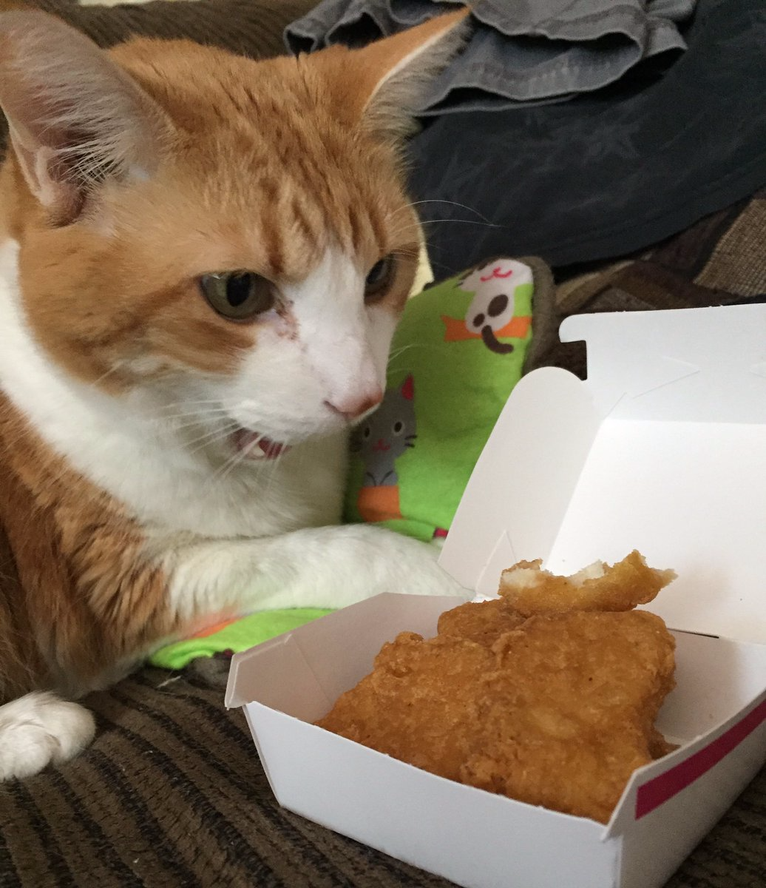

Slide 15
Comprehensions
numbers = [1,2,3,4,5]
results = []
for item in numbers: results.append(item + 5)
results
or
results = [item + 5 for item in numbers]
Quick! Easy! but confusing!
Notes:
These should all output the same thing.

Slide 16
Comprehensions
Use a list comprehension to simplify this:
names = ['Brandon', 'Ethan', 'Tony']
results = []
for name in names:
results.append('Hi my name is' + name)
results
Notes:
These should all output the same thing.

Slide 17
Comprehensions
Use a list comprehension to simplify this:
names = ['Brandon', 'Ethan', 'Tony']
results = []
for name in names:
results.append('Hi my name is' + name)
Answer:
results = ['Hi my name is ' + item for item in names]
or
results = ['Hi my name is ' + name for name in names]
Notes:
These should all output the same thing.

Slide 18
Exercise
1. Given a list of 5 numbers, use a for loop to create a new list named "data" that consists of the original numbers but with 10 subtracted from each of them.
2. Do the same thing, but simplify your code so that it uses a list comprehension.
Notes:
These should all output the same thing.

Slide 19
Comprehensions
1. Given a list of 5 numbers, use a for loop to create a new list named "data" that consists of the original numbers but with 10 subtracted from each of them.
2. Do the same thing, but simplify your code so that it uses a list comprehension.
my_list = [1,2,3,4,5]
data = []
for nugget in my_list:
data.append(nugget - 10)
or
data = [number + 10 for number in my_list]
Notes:
These should all output the same thing.

Slide 20
Exercise
Create a list of four places you would like to visit
Print out each of those places using a loop
Example:
"I would like to visit Paris"
"I would like to visit Barcelona"
"I would like to visit Lima"
"I would like to visit Havana"

Slide 21
Conditional:
do something if a condition is true
for fruit in fruits:
if fruit == "plum":
print(fruit)

Slide 22
Exercise
Create a list named hilt_class that contains the name of the people next to you. Be sure to include your own name.
Using your hilt_class list, create a conditional that prints "My name is (your name)" for your name only

Slide 23
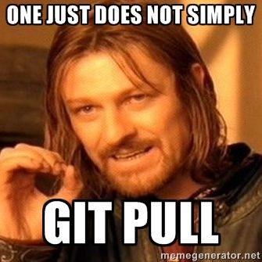

Slide 24
for loops: for dictionaries
>>> states = {"VA": "Virginia", "MD": "Maryland"}
for code, state in states.items():
print(code + " is the code for " + state)

Slide 25
range
for i in range(10):
print("I'm at number " + str(i))
for i in range(5, 10):
print("I'm at number " + str(i))
for i in range(0, 10, 2):
print("I'm at number " + str(i))

Slide 26
Fun with Lists
list.append(item) # add item to end of list
list.index(item) # searches for item and gives its index
list.remove(item) # removes first item of that name
list.reverse() # reverses the order of a list
len(list) # gives number of items in list
count(item) # counts number of that item in list
There are many more methods and things to do with list! See the List documentation here and here.

Slide 27
Branching: Do something only under certain circumstances
if fruits[0] == "plum":
print(fruits[0])
Remember: = is assignment, == is equivalence
Python one-liner:
>>> if fruits[0]=="plum":print(fruits[0])

Slide 28
Branching: Do something only under certain circumstances
Use else and elif for compound conditions. Remember the "and" and "or" operators?
if fruits[0] == "apple":
print("Yum!")
elif fruits[0] == "cardboard" or fruits[0] == "sand":
print("Yuck!")
else:
print("Not bad.")

Slide 29
Branching
if "apple" not in fruits[0]:
print("Yuck")
age = 5
if age > 0 and age <= 2:
print("baby")
elif age > 2 and age < 18:
print("child")
else:
print("adult")

Slide 30
while loop
continues while a condition is true
like an for loop with an if
counter = 0
while counter < 5:
print(counter)
counter += 1
Remember: += is shorthand for counter = counter + 1

Slide 31
“until” loop
There is no “do x until y” loop in Python, but while loops can be modified to continue until a condition is met:
counter = 0
while True:
if counter <= 5:
print(counter) counter+= 1
if counter > 5:
break
Remember: = is assignment, == is equivalence

Slide 32
slice
>>> alphabet = "abcdefghijklmnopqrstuvwxyz"
>>> alphabet[1]
"b"
>>> alphabet[2:7]
"cdefg"
>>> alphabet[-2:]
"yz"
>>> list = ["a", "b", "c", "d", "e"]
>>> list[:-1]
['a', 'b', 'c', 'd']
For more see the documentation!

Slide 33
Packages
Useful behavior beyond the "basics"
Python Standard Library
Math functions
Everything we've done so far
Python packages
Just about everything else
Anythin you might not need to use everytime

Slide 34
Installing Packages
How do you get them on your computer?
pip – stands for “Pip installs packages.” Does what it says
$ pip install a_package
Or
$ pip3 install a_different_package
Remember that we have different Python versions! Installing to one won’t install to the other.
Then import them in your code with:
import a_package_name

Slide 35
Organization: code reuse
Methods
Name code (like variables that name strings and numbers)
Take arguments
"Mini-scripts" || "Tiny commands"
Allows for code reuse
Make it easier to debug
def add(x, y):
print(x + y)
number = 4
add(3, number)

Slide 36
Methods
def method_name():
# what the method does!
All methods start with a def.

Slide 37
Methods
def method_name():
…
…
method_name()
-nothing happens when you declare a method.
- you have to call it later to execute it.

Slide 38
Methods
A method is a way of reusing the same bit of code.
DRY – Don't Repeat Yourself
print("Hi my name is Tony")
print("Hi my name is Brandon")
print("Hi my name is Ethan")
print("Hi my name is Maple")

Slide 39
Methods
A method is a way of reusing the same bit of code.
DRY – Don't Repeat Yourself
def say_hello(name):
print("Hi my name is " + name)
say_hello("Brandon")

Slide 40
Methods
A method is a way of reusing the same bit of code.
DRY – Don't Repeat Yourself
def say_hello(name):
print("Hi my name is " + name)
say_hello("Brandon")

Slide 41
Methods
say_hello("Brandon")
say_hello("Tony")
say_hello("Ethan")
say_hello("Maple")
More DRY, but we could do even better! remember our loops?

Slide 42
Methods
def say_hello(name):
print("Hi my name is " + name)
names = ["Brandon", "Tony", "Ethan", "Maple"]
for name in names:
say_hello(name)
Pretty clearly separating the data from the use of it. Nice! SO DRY

Slide 43
Variable Scope
# This is a global variable
a = 0
if a == 0:
# This is still a global variable
b = 1
def my_function(c):
# this is a local variable
d = 3
print(c)
print(d)
# Now we call the function, passing the value 7 as the first and only parameter
my_function(7)
# a and b still exist
print(a)
print(b)
# c and d don't exist anymore -- these statements will give us name errors!
print(c)
print(d)
Taken from http://python-textbok.readthedocs.io/en/1.0/Variables_and_Scope.html
Notes:
Different variable types only activate in certain parts of a code. Remember the do block with |fruit|? Fruit cease to exist outside that do block. We can organize the access of information in our code. Organization is your best defense against bugs.

Slide 44
Exercise
Write your own method!
Try to write another method that calls the first method.
Why might you want to do this?
Share with your neighbor

Slide 45
Exercise
Create a collection of these authors and the year they kicked the bucket; print the collection in the following format. Use a method to do so:
Charles Dickens kicked the bucket in 1870.
Charles Dickens, 1870
William Thackeray, 1863
Anthony Trollope, 1882
Gerard Manley Hopkins, 1889

Slide 46
An Answer
authors = {
"Charles Dickens": "1870",
"William Thackeray": "1863",
"Anthony Trollope": "1882",
"Gerard Manley Hopkins": "1889"
}
for author, date in authors.items():
print(author + " kicked the bucket in " + date)

Slide 47
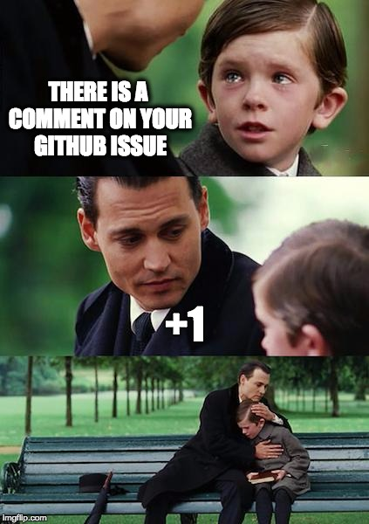

Slide 48
Exercise
A time traveler has suddenly appeared in the classroom!
Create a variable representing the traveller's year of origin (e.g., year = 2000) and greet our strange visitor with a different message if he is from the distant past (before 1900), the present era (1900-2020) or from the far future (beyond 2020).

Slide 49
An Answer
year = 2000
if year < 1900:
print("Tell me of the past!")
elif year >= 1900 and year <= 2020:
print("I wish you were from a cooler era.")
else:
print("Hello, future traveller.")
Rewrite (refactor) as a method to test different years

Slide 50
An Answer: improved
def greeting(year):
if year < 1900:
print("Tell me of the past!")
elif year >= 1900 and year <= 2020:
print("I wish you were from a cooler era.")
else:
print("Hello, future traveller.")
greeting(1878)
greeting(2013)
greeting(3000)

Slide 51
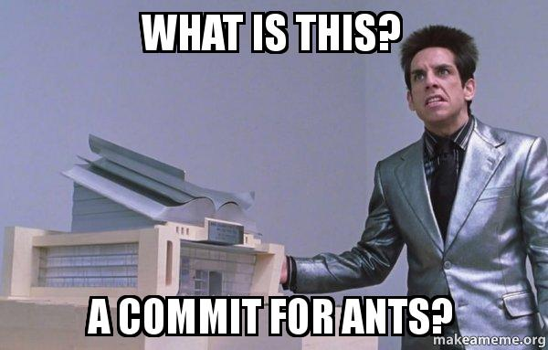

Slide 52
Exercise
Create a collection of 19th- and 20th-century authors (or historical/political figures if that's your bag!) and their birth dates (historical accuracy doesn't matter). An example:
birth_dates = {"Wallace Stevens": 1879}
Count the number of 19th-century birth dates and the number of 20th-century birth dates, then print the results like:
There are 3 19th-c. births and 2 20th-c. births in my collection.

Slide 53
An Answer
birth_dates = {'Wallace Stevens': 1897, 'Brandon Walsh': 1977}
nineteenth_count = 0
twentieth_count = 0
for person, b_date in birth_dates.items():
if b_date < 1900:
nineteenth_count += 1
else:
twentieth_count += 1

Slide 54
An Answer: continued
print("There are " + str(nineteenth_count) + " 19th-c. births and " + str(twentieth_count) + " 20th-c. births in my collection.")
How might you expand this to capture additional centuries? Decades?

Slide 55
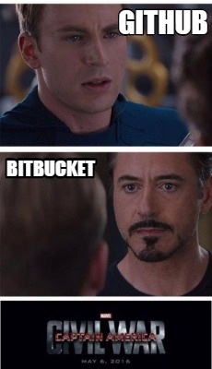

Slide 56
Questions?

